Slide 1
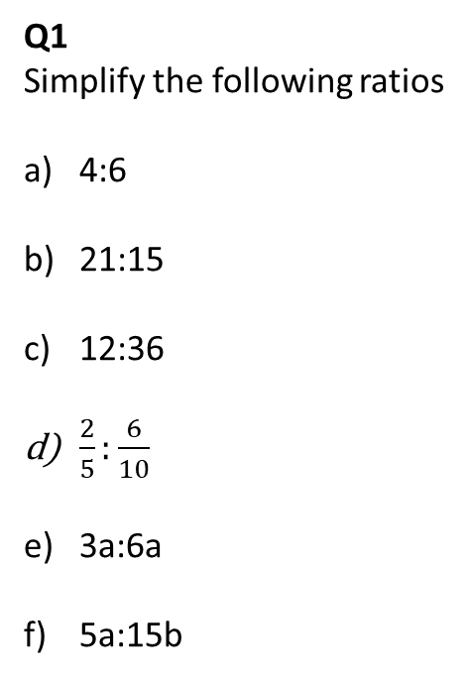
Please answer as many questions as you can
Q1
Simplify the following ratios
4:6
21:15
12:36
$\frac{2}{5}:\frac{6}{10}$
3a:6a
5a:15b
Q2
Share the following into the given ratios
£30 into 1:2:3
4km into 3:7
Q4
In his pocket, Bill has 50p and 20p coins in the ratio, 4:7.
He has less than £15.
What is the maximum number of 50p coins in Bill’s pocket?
Q3
Solve the following problem
A triangle has angles in the ratio 3:5:2.
Is it a right angled triangle?

Slide 2
Simplifying Ratios
Achildsguideto.com

Slide 3
Keywords
Ratio – The relation between two magnitudes in respect of quantity as determined by the number of times that one contains the other.
Notation – How we write something. In this case, we write 3:5:6 and say “3 to 5 to 6.”
Simplify – make something easy. In this case, we try to make the numbers as small as possible but try to keep them as integers.

Slide 4
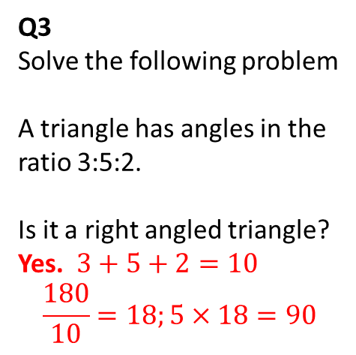
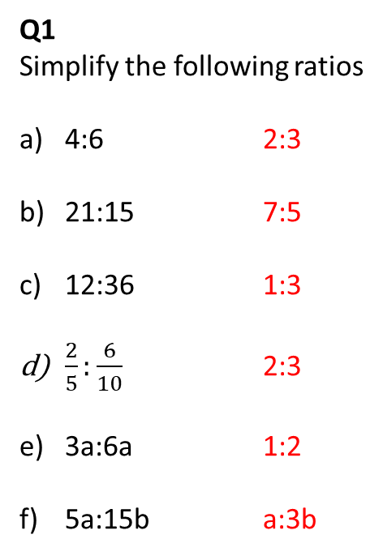
Please answer as many questions as you can
Q1
Simplify the following ratios
4:6 2:3
21:15 7:5
12:36 1:3
$\frac{2}{5}:\frac{6}{10}$ 2:3
3a:6a 1:2
5a:15b a:3b
Q2
Share the following into the given ratios
£30 into 1:2:3 £5:£10:£15
4km into 3:7 1.2 : 2.8km
Q4
In his pocket, Bill has 50p and 20p coins in the ratio, 4:7.
He has less than £15.
What is the maximum number of 50p coins in Bill’s pocket?
Q3
Solve the following problem
A triangle has angles in the ratio 3:5:2.
Is it a right angled triangle?
Yes. $3+5+2=10$
$$\frac{180}{10}=18;5×18=90$$
4:7 have no common factors
Simplest form.
(4×50) + (7×20) = £3.40
£3.40, £6.80, £10.20, £13.60, £17 > £15
16 coins

Slide 5
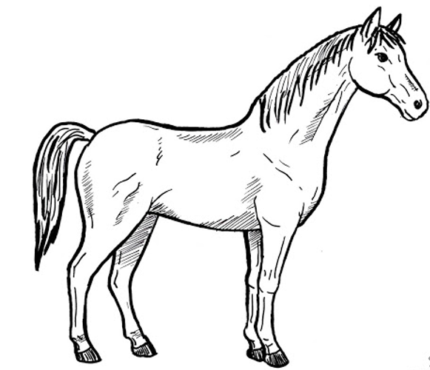
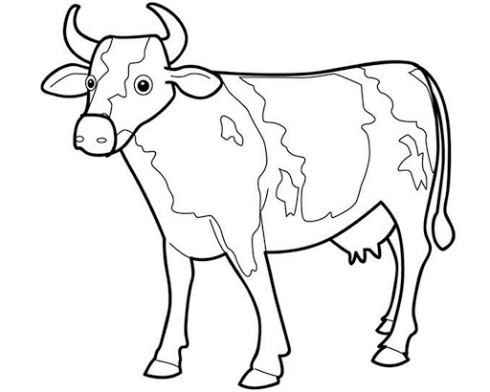
Write as a ratio of horses to cows
3 horses to 5 cows
3:5
To be able to use ratio notation

Slide 6
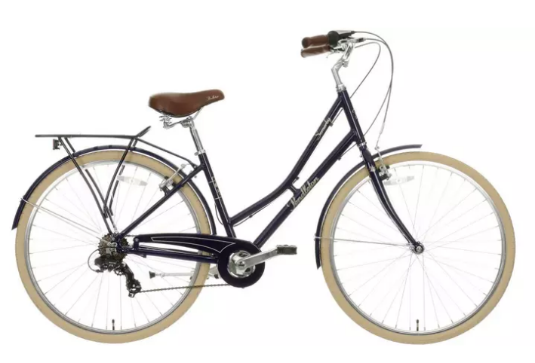
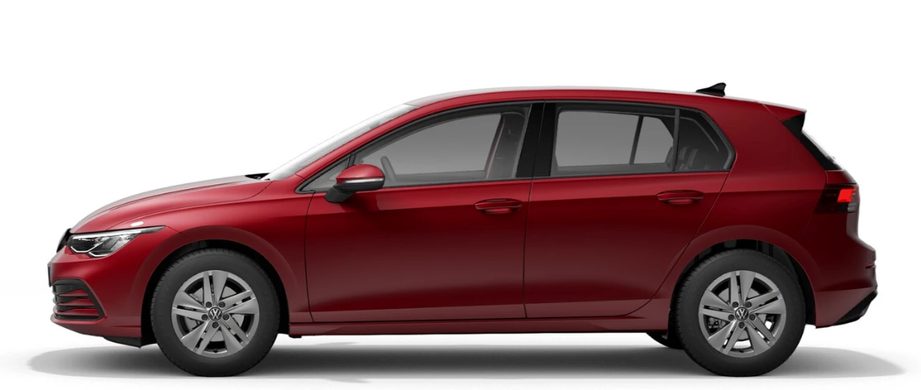
Write as a ratio of bicycles to cars
7:2
To be able to use ratio notation

Slide 7
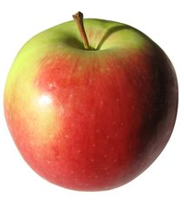
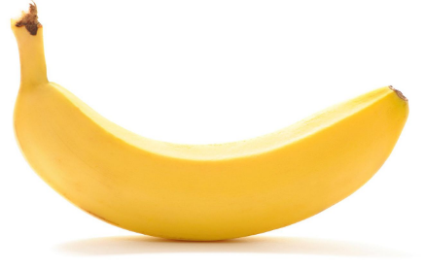
Write as a ratio of apples to bananas
7:3
To be able to use ratio notation

Slide 8

What has been done to simplify these ratios?
10 : 6
5 : 3
24 : 6
4 : 1
180 : 54
10 : 3
8a : 5a
8 : 5
6a : 12b
a : 2b
$$\frac{7}{21} : \frac{21}{42}$$
2 : 3
To be able to write ratios in the simplest form

Slide 9

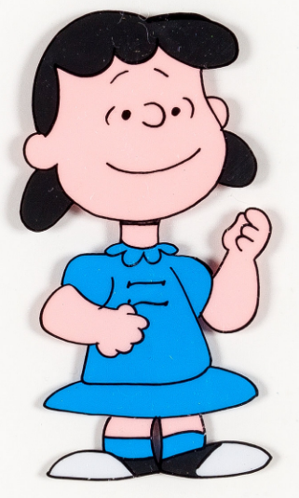
How do we simplify ratios, Lucy?
To simplify ratios, find the highest common factor and then divide all the parts of the ratio by that factor.
To explain your reasoning

Slide 10
Simplify these ratios.
14 : 6
7a : 7b
a : b
7 : 3
To be able to write ratios in the simplest form

Slide 11
Simplify these ratios.
63 : 27
6a : 18a
7 : 3
1 : 3
To be able to write ratios in the simplest form

Slide 12
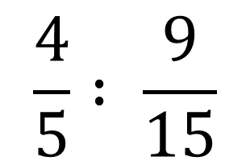
Simplify these ratios.
24 : 156
$$\frac{4}{5} : \frac{9}{15}$$
2 : 13
4 : 3
To be able to write ratios in the simplest form

Slide 13
How can we tell if it is the simplest form of the ratio, Lucy?
If the numbers in the ratio are prime then that is a big clue.
Alternatively, the numbers may be mutually prime, they don’t appear in a times table with each other.
To explain your reasoning

Slide 14
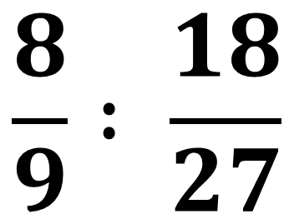
Write down ten equivalent ratios:
14 : 20
18k : 20k
$$\frac{8}{9} : \frac{18}{27}$$
6 : 30 : 18
To be able to write ratios in the simplest form

Slide 15
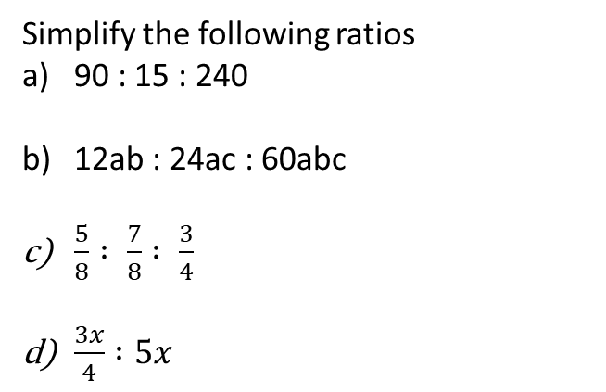
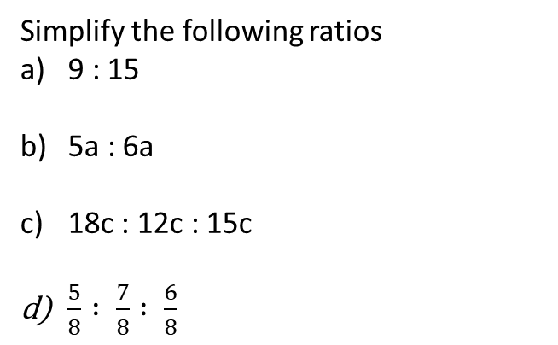
Score ≤ 7 Score > 8
Simplify the following ratios
9 : 15
5a : 6a
18c : 12c : 15c
$\frac{5}{8} : \frac{7}{8} : \frac{6}{8}$
Simplify the following ratios
90 : 15 : 240
12ab : 24ac : 60abc
$\frac{5}{8} : \frac{7}{8} : \frac{3}{4}$
$\frac{3x}{4} :5x$
3 : 5
5 : 6
6 : 4 : 5
5 : 7 : 6
6 : 1 : 16
b : 2c : 5bc
5 : 7 : 6
3 : 20
Simplify the following measurement ratios:
4cm : 10mm
60cm : 1.05m
3kg : 1200g
2hrs : 80 mins
Simplify the following measurement ratios:
4cm : 30mm
60cm : 1.65m
3kg : 1400g
2hrs : 15 mins
4 : 1
4 : 7
5 : 2
3 : 2
4 : 3
4 : 11
15 : 7
8 : 1
To be able to write ratios in the simplest form

Slide 16
Score ≤ 7 Score > 8
125 women and 150 men attend a wedding. Write the ratio of men to women in its simplest form.
A decorator mixes 65 litres of red with 15 litres of blue paint. What is the ratio of red to blue mixed in its simplest form?
A model plane has a wingspan of 30cm. The real plane’s wingspan is 60m. What is the ratio of model to real life in its simplest form?
A recipe contains 0.3kg of sugar 50g of butter. What is the ratio of butter to sugar in its simplest form?
125 women attend a wedding. The ratio of men to women is 7 : 5. How many men attend the wedding?
A decorator needs to mix 65 litres of red paint to 15 litres of blue to achieve a certain hue of purple. He runs out of paint and finds he needs 3.2 litres more purple. How much red and blue paint does he need?
A model has a scale of 1:48. The wingspan on the model is 28.9cm. What is the actual wingspan of the aircraft?
A recipe contains 0.3kg of sugar, 49.5g of butter. What is the ratio of butter to sugar in its simplest form?
6 : 5
175 men
2,600ml red
600ml blue
13 : 3
1 : 200
13.872m
1 : 6
200 : 33
To be able to apply this to problem solving tasks

Slide 17
Explain…
How do we simplify ratios?
How do we know that a ratio is in its simplest form?
Keywords…
Ratio
Notation
Simplify
To explain your reasoning

